Slide 1


Problem Solving

Slide 2
Four strategies for Problem Solving
Problem Definition
2. Logical Reasoning
3. Decomposition
4. Abstraction

Slide 3
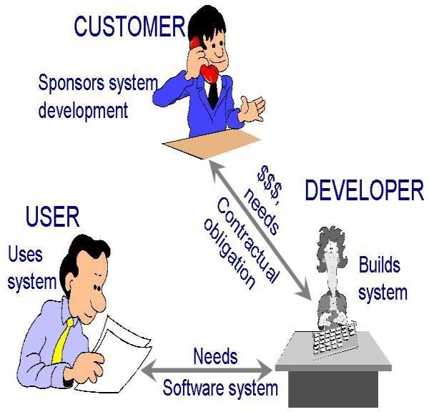
PROBLEM DEFINITION: A software perspective
Software development follows a similar style as the general problem solving.
Three major steps of software development.
  Analysis,
  Design and
  Implementation.
The stakeholders of a software include,
Customer
request for software to developed.
Software developer
usually a team to build the software.
User
who will be using the software finally.
Figure: stakeholders of software

Slide 4
The relationship
Software Analysis == Problem Definition.
Design + Implementation == Problem Solution
(Logical Reasoning, Decomposition, Algorithm and Abstraction).

Slide 5
Significance of Problem Definition
References Problem Definition
( Task + goal specification)
Software Analysis/ Problem Definition-- specifies
WHAT task(s) are to be performed by the program/ software
serves as the software developer's goal
Problem solution = Design--- Algorithm Implementation = Program/ Software
Verification of the Program / Software developed

Slide 6
Problem definition / software analysis
Start with the task of communicating with customers and users to determine what their requirements are
  This is formally called as requirements gathering.
What are requirements?
  The features of system or system function
  They fulfill system purpose(s).
Steps of defining a problem in software
Gather requirements
Analyze requirements
determining whether the stated requirements are unclear, incomplete, ambiguous, or contradictory, and then resolving these issues.
Recording requirements
requirements might be documented in various forms, usually as
standard document formats.

Slide 7

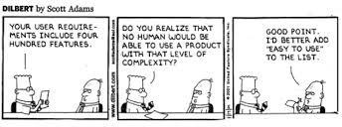
Analysis needs customer and developer interaction - to prepare legal agreement.
Requirements document - records “what” is to be built NOT “how” it is to be built.
Successful design and implementation rests on adequate analysis.

Slide 8


Vanilla Ice cream that puzzles General Motors
This is a real story that happened between the customer of General Motors and its
Customer-Care Executive
A complaint was received by the Pontiac Division of General Motors
Complaint:
“This is the second time I have written to you, and I don’t blame you for not answering me, because I sounded crazy.
It seems my car has a problem with Vanilla Icecream !!!!!”
Vs
Department of CSE,Coimbatore

Slide 9

Vanilla Ice cream that puzzles General Motors (Contd)
Detailed Description:
“It is a fact that we have a tradition in our family to have Ice-Cream for dessert after dinner each night.
But the kind of ice cream varies so, every night, after we’ve eaten, the whole family votes on which kind of ice cream we should have
And … I drive down to the store to get it. It’s also a fact that I recently purchased a new Pontiac and since then my trips to the store have created a problem….”

Slide 10
Vanilla Ice cream that puzzles General Motors (Contd)
You see, every time I buy a vanilla ice-cream, when I start back from the store my car won’t start.
If I get any other kind of ice cream, the car starts just fine. I want you to know I’m serious about this question, no matter how silly it sounds “What is there about a Pontiac that makes it not start when I get vanilla ice cream, and easy to start whenever I get any other kind?”

Slide 11

Vanilla Ice cream that puzzles General Motors (Contd)
If YOU were that engineer, what kind of approach will you take for arriving at the exact problem ?

Slide 12
Vanilla Ice cream that puzzles General Motors (Contd)
The Engineer was surprised to be greeted by a successful, obviously well educated man in a fine neighborhood.
He had arranged to meet the man just after dinner time, two hopped into the car and drove to the ice cream store. It was vanilla ice cream that night and, sure enough, after they came back to the car, it wouldn’t start.
The Engineer returned for three more nights.
  The first night, they got chocolate.The car started.
  The second night, they got strawberry.The car started.
  The third night they ordered vanilla. The car failed to start.

Slide 13
Vanilla Ice cream that puzzles General Motors (Contd)
Now the engineer, being a logical man, refused to believe that this man’s car
was allergic to vanilla ice cream.
He arranged, therefore, to continue his visits for as long as it took to solve the problem. And toward this end he began to take notes:
He jotted down all sorts of data: time of day, type of gas uses, time to drive
back and forth etc.
In a short time, he had a clue: the man took less time to buy vanilla than any
other flavor.Why?
The answer was in the layout of the store.

Slide 14
Vanilla Ice cream that puzzles General Motors - SOLUTION
The answer was in the layout of the store.
  Vanilla, being the most popular flavor, was in a separate case at the front of the store for quick pickup. All the other flavors were kept in the back of the store at a different counter where it took considerably longer to check out the flavor.
Now, the question for the Engineer was why the car wouldn’t start when it took less time. Eureka – Time was now the problem – not the vanilla ice cream!!!! The engineer quickly came up with the answer: “vapor lock”.

Slide 15

Vanilla Ice cream that puzzles General Motors - SOLUTION
Why Vapor Lock Happened?
It was happening every night;
But the extra time taken to get the other flavors allowed the engine to cool down sufficiently to start. When the man got vanilla, the engine was still too hot for the vapor lock to dissipate.
Crazy looking problems are sometimes real and all problems seem to be simple only when we find the solution, with computational thinking.
“It is not Ice cream Problem, BUT Computational thinking problem”

Slide 16
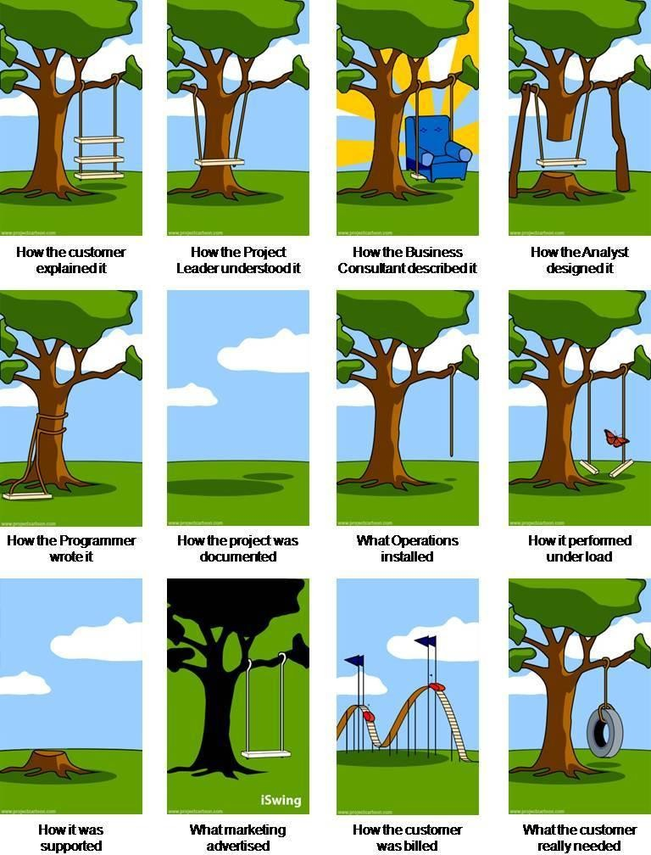
15 Department of CSE

Slide 17

Video Player Application
A informal description of a Video Player Application is as follows:
The application plays a video with buttons that allow the user to play or pause the video, as well as to raise or lower the sound volume.
  Can you list the software requirements ( system features / functionalities) for this?

Slide 18
Solution
The list of software requirements include:
  Play/ Pause video
  Increase/Decrease Volume
  Run and exit application
  Maximize or Minimize window
  Measure screen refresh time
  Rate of failure
  Time to restart after failure
  Percentage of events causing failure

Slide 19
Types of requirements
The two major types of requirements to define a problem:
  Functional requirements: specifies the particular task(s) the software must perform.
  Non-functional requirements: defines other characteristics and constraints related to the software.
    Now inVideo Player app, categorize the software requirements

Slide 20
Solution
The list of functional requirements include:
  Play/ Pause video
  Increase/Decrease Volume
  Run and exit application
  Maximize or Minimize window
The list of non-functional requirements include:
  Measure screen refresh time
  Rate of failure
  Time to restart after failure
  Percentage of events causing failure

Slide 21

In general,
functional requirements include
  Input/output
  Processing
  Error handling
non-functional requirements include:
  Reliability
  Safety
  Security
  Performance
  Delivery
  Help facilities

Slide 22


A detailed look into requirements of the video app
Icon | Index | Function Name | Description
 | V1 | Play | Clicking the play causes the video to begin playing If the video was just paused, then playing the video resumes at the point of pausing If the video has yet to start playing then a new computer window is created and video begins playing in the window So long as the video is playing the pause/play button functions as a pause button displaying a pause button image
 | V2 | Pause | Clicking the pause button causes the video to pause at the current play location If the video has already finished playing, then this button has no effect Clicking the pause button causes the pause/play button to function as a play button, displaying a play button image

Slide 23


Icon | Index | Function Name | Description
 | V3 | Increase Volume | Clicking the increase volume button while the volume is less than maximum 80 dB level causes the volume to increase by 5 dB Clicking the increase volume button while volume is at 80 dB level does nothing
 | V4 | Decrease Volume | Clicking the decrease volume button while the volume is greater than silent (0 dB) level causes the volume to decrease by 5 dB Clicking the decrease volume button while volume is at silent level does nothing

Slide 24
Functional requirement validation
We ask the questions
Correct?
Consistent?
Complete?

Slide 25
Correctness
  means that customers, users, and developers understand in the specified requirements in the same way
  To check correctness, functional requirements can be translated into a logical proposition.
V2(pause) is expressed as a logical expression as follows : “If the video has already finished playing, then this button has no effect”.
Symbolically we have,
  F: the video has finished playing.
  N : no change kind of action.
  F implies N
•

Slide 26
Consistency
means no two functions contradict each another
Consider adding a new function to the video app
Let V5 be the requirement to restart video
Its description is :
“When the video is playing and reaches the end, it immediately playing with the play/pause button functioning as a play button.”
Does this contradict with any of the requirements V1 to V4?
  Yes, this would contradict V1(play) specification
restarts
V1 states that , the play/pause button should function as a pause button when videos are playing
Whereas V5 states that the play/pause button should function as a play
button when videos are playing

Slide 27
Completeness
takes careful consideration to be certain that every possible scenario has been considered and explained in one or more requirement(s)
There are two ways to ensure completeness :
  Manually check and add functions if required
  A rather formal way is to check all possible combination of situations by constructing State-activity table
    For a complete set of functional requirements, the state activity table contains requirements in every cell except those that are impossible.

Slide 28
Template for state activity table
Application
states
User actions/ activity
A requirement that describes the state-action combination is noted
An impossible state-action combination is left blank
27

Slide 29
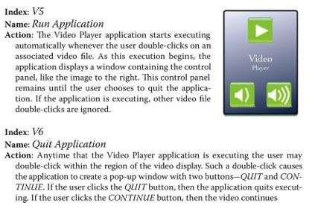
Validating for completeness in the video app
Consider the two non contradicting additional requirementsV5 ( Run application) and V6 (Quit application)

Slide 30
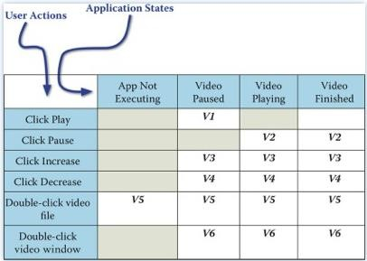
State activity table for video app ( V1 to V6)
Figure: State-activity table for the video player app

Slide 31


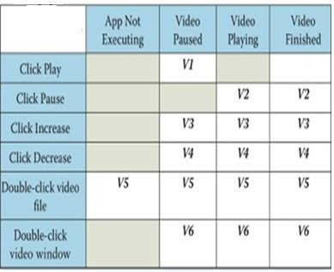
Impossible state-action combinations in video app
It is impossible for the user to click any of the buttons of the control panel while in the App Not Executing state
Requirement V1(play) specifies that when a video is playing the pause function is active, making it impossible to click the play button
Requirement V2(pause) states that clicking the pause button causes the control panel to display on the play button, making another click of the pause impossible
atore

Slide 32
Check for completeness in the video app
Is the state activity table complete?
No, there is an unfilled cell on upper
right.
The requirements V1 to V6 do not really explain what occurs when the video has played to completion and the user clicks the play button.
  Pause button being clicked when video finished playing causes the play button to be ON but how is this handled?
    Perhaps play should restart video or terminate app or do nothing --- but define it.

Slide 33

What has been described?
Construction of functional requirements.
Checking the uniform understanding of the functions identified in the problem.
Checking contradictions in the functional descriptions
Checking for completeness using state activity table.
Credits:
http://www.bbc.co.uk/education/guides/zp92mp3/revision
http://courses.cs.vt.edu/cs2104/Summer2014/

